Slide 1
Observer Pattern Demo: Problem Statement
You are a weather researcher working at a station that tracks the current conditions (e.g. the temperature and humidity) that day and calculates the current average, minimum, and maximum values for those conditions. However, weather data is constantly changing, so there needs to be a system that can update the weather station with these values and factor them in the new calculations.

Slide 2
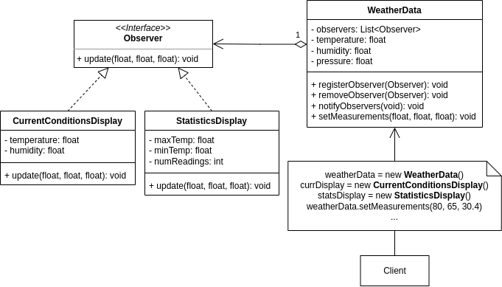
Why use the observer pattern?
With the observer pattern, we can have the displays for current conditions and statistics (CurrentConditionsDisplay and StatisticsDisplay) implement an Observer interface.
Each display class also registers itself as an observer of the WeatherData class. When WeatherData sets new measurements, it notifies all its observers (the displays); then each observer will update their own displays with the new values.

